Slide 1
Connect4IUC /
VLIR-UOS & Tanzania
Evelien Meylemans
Notes:
VLIR-UOS: new approach for partner countries

Slide 2
What’s new?
2030 Agenda for Sustainable Development
Country strategy approach
→ SDG centred approach
SDG Principles:
Leaving No One Behind (LNOB)
Multistakeholder partnerships
Interconnectedness

Slide 3
What’s new?
Focus on connecting
Country Reference Frameworks
2030 Agenda
Higher education context
Other (Belgian) actors
Joint Strategic Frameworks (JSFs)
Thematic JSF HES4SD
Geographic JSF Tanzania
SharePoint tool (in development)
Notes:
The Country Reference Framework (CRF) for Tanzania supports teams of academics when identifying and formulating project proposals:
by providing a context analysis focused on Agenda 2030 on Sustainable Development and the higher education sector in Tanzania
and by providing an overview of Belgian development actors active in Tanzania, their ongoing projects and partners, in view of exploration of opportunities for synergy and complementarity.
Country Reference Frameworks as information/connecting hubs
Thematic JSF: higher education and science for sustainable development
SharePoint tool: connecting & exchanging between 5 new IUCs, later open to others

Slide 4
VLIR-UOS website
Country page Tanzania (Link)
IUC Phase In ARU (Link)

Slide 5
How to connect with ARU?
Coordinators:
Tanzanian coordinator: Gabriel Kassenga, kassengagr@gmail.com
Flemish coordinator: Rob Cuyvers, Rob.cuyvers@uhasselt.be
Managers:
Tanzanian manager: Mara-Saada Mwinyigogo, malaikasouliee@gmail.com
Flemish manager: Liesbeth Oeyen, liesbeth.oeyen@uhasselt.be

Slide 6
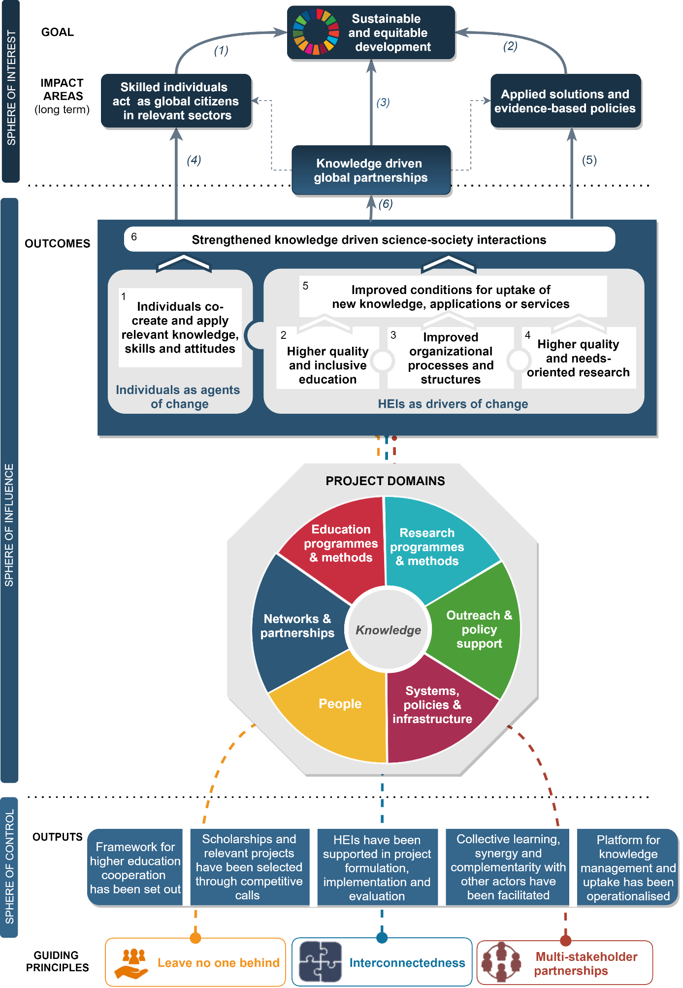
What’s new?
Revised Theory of Change
Focus on two strategic axes:
Enabling HEIs to strengthen and take up their role as Drivers of Change
Enabling individuals to become and act as Agents of Change
Along these strategic axes
→ 6 outcomes
IUCs as long-term partnerships can contribute potentially to all outcomes

